Slide 1
Fundamentals of Machine Learning

Slide 2
Outline
Rank of a matrix
Row Echelon Form
Low-rank matrix Approximation

Slide 3
Rank of a matrix
The rank of a matrix is defined as (a) the maximum number of linearly independent column vectors in the matrix or (b) the maximum number of linearly independent row vectors in the matrix.
For an m x n matrix,
If m is less than n, then the maximum rank of the matrix is m.
If m is greater than n, then the maximum rank of the matrix is n.
Note : The rank of a matrix would be zero only if the matrix had no elements. If a matrix had even one element, its minimum rank would be one.
The maximum number of linearly independent vectors in a matrix is equal to the number of non-zero rows in its row echelon matrix.
Therefore, to find the rank of a matrix, transform the matrix to its row echelon form and count the number of non-zero rows.

Slide 4
Linear independence
A set of vectors {v₁,v₂,...,v_{k}} is linearly independent if the vector equation
x₁v₁+x₂v₂+···+x_{k}v_{k}=0
has only the trivial solution x₁=x₂=···=x_{k}=0.
The set of vectors {v₁,v₂,...,v_{k}} is linearly dependent if there exist numbers x_{1,}x_{2,}···,x_{k}, not all equal to zero, such that
x₁v₁+x₂v₂+···+x_{k}v_{k}=0
This is called a linear dependence relation or equation of linear dependence.

Slide 5
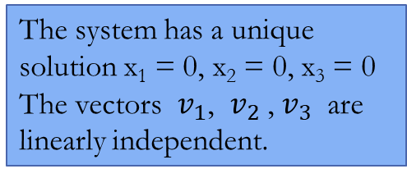
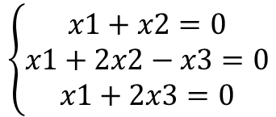
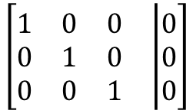
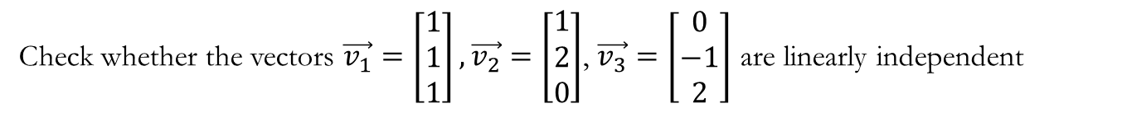
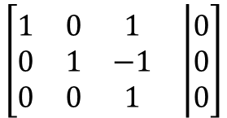
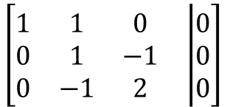
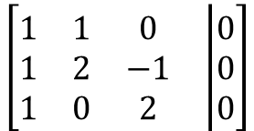
Example
Check whether the vectors $\vec{v_{1}}=\left[\begin{matrix}1 \\ 1 \\ 1\end{matrix}\right],\vec{v_{2}}=\left[\begin{matrix}1 \\ 2 \\ 0\end{matrix}\right]$, $\vec{v_{3}}=\left[\begin{matrix}0 \\ −1 \\ 2\end{matrix}\right]$ are linearly independent
Solution : Calculate the coefficients in which a linear combination of these vectors is equal to the zero vector.
x1v1 + x2v2 + x3v3 = 0
This vector equation can be written as a system of linear equations
R2→R2-R1
R3→R3-R1
$$\left[\begin{matrix}\begin{matrix}1 & 1 & 0 \\ 0 & 1 & −1 \\ 0 & −1 & 2\end{matrix} & \left|\begin{matrix}0 \\ 0 \\ 0\end{matrix}\right.\end{matrix}\right]$$
$$\left\{\begin{aligned}x1+x2=0 \\ &x1+2x2−x3=0 \\ x1+2x3=0\end{aligned}\right.$$
R1→R1-R2
R3→R3+R2
$$\left[\begin{matrix}\begin{matrix}1 & 0 & 1 \\ 0 & 1 & −1 \\ 0 & 0 & 1\end{matrix} & \left|\begin{matrix}0 \\ 0 \\ 0\end{matrix}\right.\end{matrix}\right]$$
The system has a unique solution x₁ = 0, x₂ = 0, x₃ = 0
The vectors $v_{1}$, $v_{2}$, $v_{3}$ are linearly independent.
Solve using Gauss elimination method
$$\left[\begin{matrix}\begin{matrix}1 & 1 & 0 \\ 1 & 2 & −1 \\ 1 & 0 & 2\end{matrix} & \left|\begin{matrix}0 \\ 0 \\ 0\end{matrix}\right.\end{matrix}\right]$$
R1→R1-R3
R2→R3+R2
$$\left[\begin{matrix}\begin{matrix}1 & 0 & 0 \\ 0 & 1 & 0 \\ 0 & 0 & 1\end{matrix} & \left|\begin{matrix}0 \\ 0 \\ 0\end{matrix}\right.\end{matrix}\right]$$

Slide 6
Question 1: - Consider the following row vectors below:
x= $\left[\begin{matrix}2 & 1 & 0\end{matrix}\right]$ , y= $\left[\begin{matrix}1 & 2 & 3\end{matrix}\right] z=\left[\begin{matrix}3 & 3 & 3\end{matrix}\right]$ , w= $\left[\begin{matrix}5 & 4 & 3\end{matrix}\right]$
Which of the following statements are true?
(A) Vectors x, y, and z are linearly dependent. (B) Vectors x, y, and w are linearly dependent. (C) Vectors y, z, and w are linearly dependent. (D) All of the above. (E) None of the above.
Solution
The correct answer is (D), as shown below.
Vectors x, y, and z are linearly dependent, since x + y = z.
Vectors x, y, and w are linearly dependent, since 2x + y = w.
Vectors y, z, and w are linearly dependent, since 2z - y = w.

Slide 7
Question 2: Rank of a matrix is
A) number of zero rows in that matrix
B) number of zero rows in its echelon form of matrix
C) number of non-zero rows in that matrix
D) number of non-zero rows in its echelon form of matrix

Slide 8
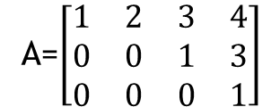
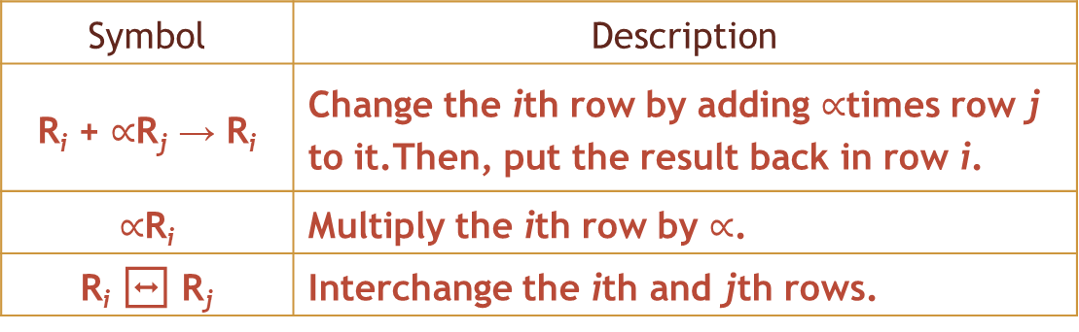
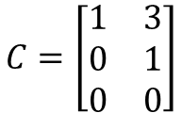
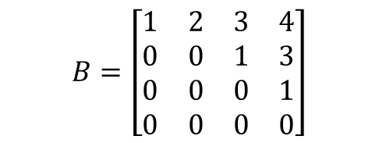
Row Echelon Form (REF)
A matrix is in row echelon form (ref) when it satisfies the following conditions.
The first non-zero element in each row, called the leading entry, is 1.
Each leading entry is in a column to the right of the leading entry in the previous row.
Rows with all zero elements, if any, are below rows having a non-zero element.
Row-Echelon form - by applying elementary row operations. Three basic row operations are :
interchange two rows (swapping)
Multiply one of the rows by a nonzero constant
Add a multiple of one row to another row.
Example:
A=$\left[\begin{matrix}1 & 2 & 3 & 4 \\ 0 & 0 & 1 & 3 \\ 0 & 0 & 0 & 1\end{matrix}\right]$
$$C=\left[\begin{matrix}1 & 3 \\ 0 & 1 \\ 0 & 0\end{matrix}\right]$$
Symbol | Description
R_{i} + $∝$R_{j}→ R_{i} | Change the ith row by adding $∝$times row j to it.Then, put the result back in row i.
$∝$R_{i} | Multiply the ith row by $∝$.
R_{i}↔ R_{j} | Interchange the ith and jth rows.
$$B=\left[\begin{matrix}1 & 2 & 3 & 4 \\ 0 & 0 & 1 & 3 \\ 0 & 0 & 0 & 1 \\ 0 & 0 & 0 & 0\end{matrix}\right]$$

Slide 9
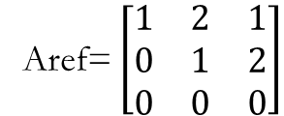
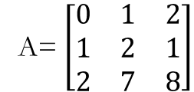
Example : Consider matrix A and its row echelon matrix, A_{ref}.
A= $\left[\begin{matrix}0 & 1 & 2 \\ 1 & 2 & 1 \\ 2 & 7 & 8\end{matrix}\right]$
Aref= $\left[\begin{matrix}1 & 2 & 1 \\ 0 & 1 & 2 \\ 0 & 0 & 0\end{matrix}\right]$
The row echelon form A_{ref} has two non-zero rows, Hence, the matrix A has two independent row vectors;
Therefore,the rank of matrix A is 2.
When all of the vectors in a matrix are linearly independent, the matrix is said to be full rank.

Slide 10
Low-rank approximation

Slide 11
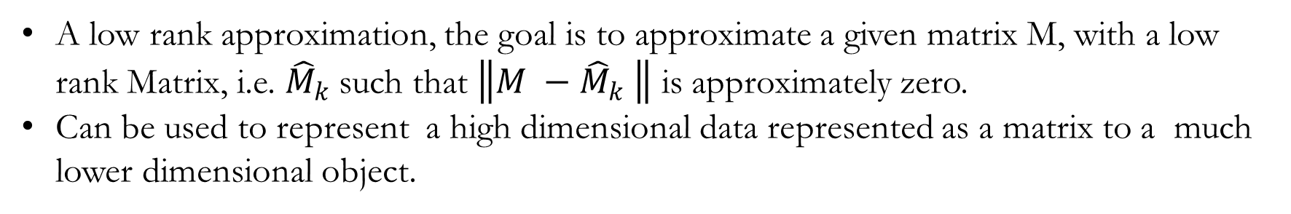
Low rank Matrix Approximation
A low-rank approximation provides a (lossy) compressed version of the matrix.
A low rank approximation, the goal is to approximate a given matrix M, with a low rank Matrix, i.e. ${\hat{M}}_{k}$such that $\left\|M −{\hat{M}}_{k} \right\|$ is approximately zero.
Can be used to represent a high dimensional data represented as a matrix to a much lower dimensional object.

Slide 12
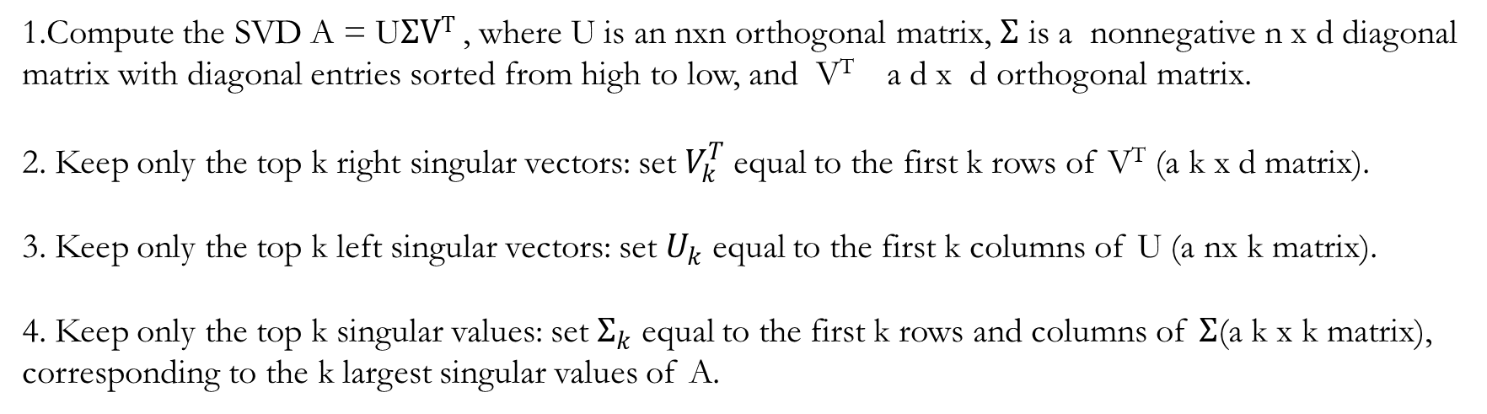
Given an n × d matrix A and a target rank k ≥ 1, a rank-k approximation of A as follows:
1.Compute the SVD A = U$ΣVT$, where U is an nxn orthogonal matrix, $Σ$ is a nonnegative n x d diagonal matrix with diagonal entries sorted from high to low, and V^{T} a d x d orthogonal matrix.
2. Keep only the top k right singular vectors: set $V_{k}^{T}$equal to the first k rows of V^{T} (a k x d matrix).
3. Keep only the top k left singular vectors: set $U_{k}$ equal to the first k columns of U (a nx k matrix).
4. Keep only the top k singular values: set $Σ_{k}$ equal to the first k rows and columns of $Σ$(a k x k matrix), corresponding to the k largest singular values of A.
The computed Low rank approximation is$A_{k }$=$U_{k}Σ_{k}V_{k}^{T}$
Source : theory.stanford.edu/~tim/s15/l/l9.pdf

Slide 13


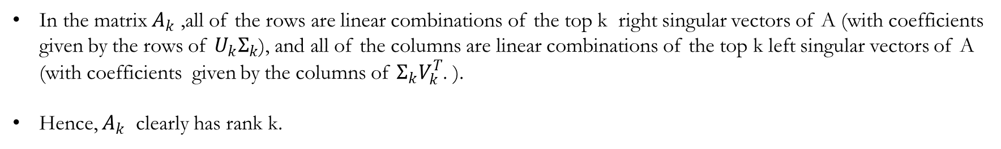

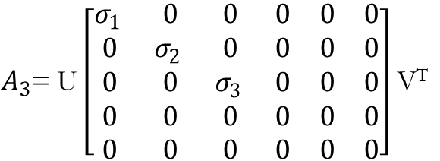
$A_{k }$=$U_{k}Σ_{k}V_{k}^{T}$
In the matrix $A_{k}$ ,all of the rows are linear combinations of the top k right singular vectors of A (with coefficients given by the rows of $U_{k}Σ_{k}$), and all of the columns are linear combinations of the top k left singular vectors of A (with coefficients given by the columns of $Σ_{k}V_{k}^{T}$. ).
Hence, $A_{k}$ clearly has rank k.
Example: Let A is 5 x 5 matrix with $σ_{1 }$=3,$σ_{2 }$=1,$σ_{3 }$=0.5,$σ_{4 }$=0.2 and $σ_{5 }$=0.1 matrix and A=U$ΣVT$
$A_{3}$= U $\left[\begin{matrix}σ_{1 } & 0 & 0 & 0 & 0 & 0 \\ 0 & σ_{2 } & 0 & 0 & 0 & 0 \\ 0 & 0 & σ_{3 } & 0 & 0 & 0 \\ 0 & 0 & 0 & 0 & 0 & 0 \\ 0 & 0 & 0 & 0 & 0 & 0\end{matrix}\right]$ V^{T}
$$= \left[\begin{matrix} & & & & \\ & & & & \\ & & & & \\ & & & & \\ & & & & \end{matrix}\right]$$
$$Σ_{k}$$
The rank-k approximation derived from the SVD of A
3 x 3
5 x 3
3 x 5
5 x 5

Slide 14
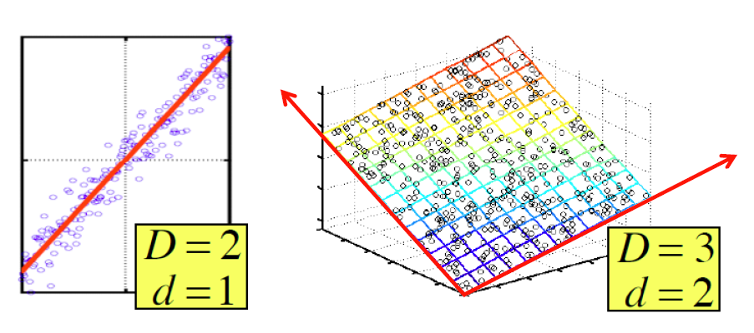
Dimensionality Reduction
Goal of dimensionality reduction is to discover the axis of data!
Rather than representing every point with 2 coordinates we represent each point with
1 coordinate (corresponding to the position of the point on the red line).
By doing this we incur a bit of error as the points do not exactly lie on the line

Slide 15
Why Reduce Dimensions?
Why reduce dimensions?
Discover hidden correlations/topics
Words that occur commonly together
Remove redundant and noisy features
Not all words are useful
Interpretation and visualization
Easier storage and processing of the data

Slide 16
Dimensionality Reduction Using SVD
To reduce the dimensionality of the three matrices (U,V and S )is to set the smallest of the singular values to zero.
Eliminate the corresponding columns of U and V .
Source : http://infolab.stanford.edu/~ullman/mmds/ch11.pdf

Slide 17
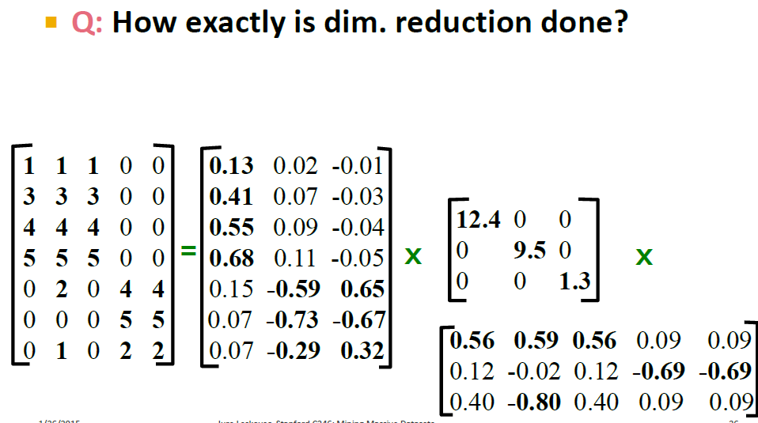

Slide 18
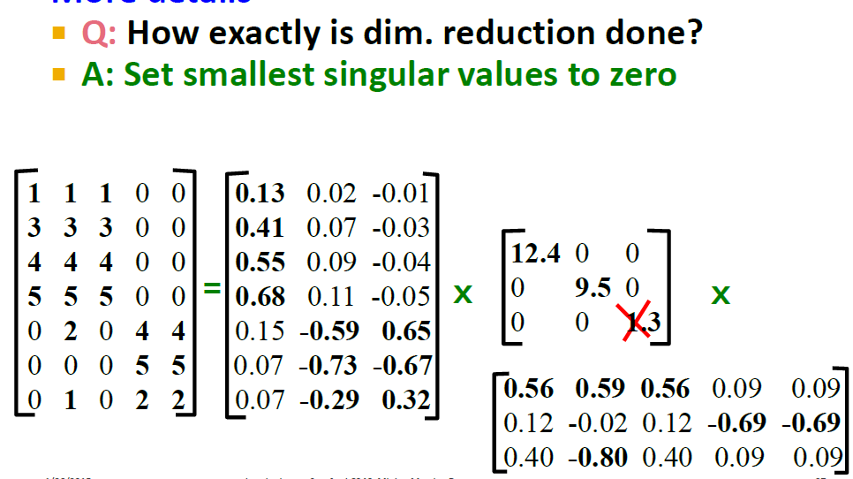

Slide 19
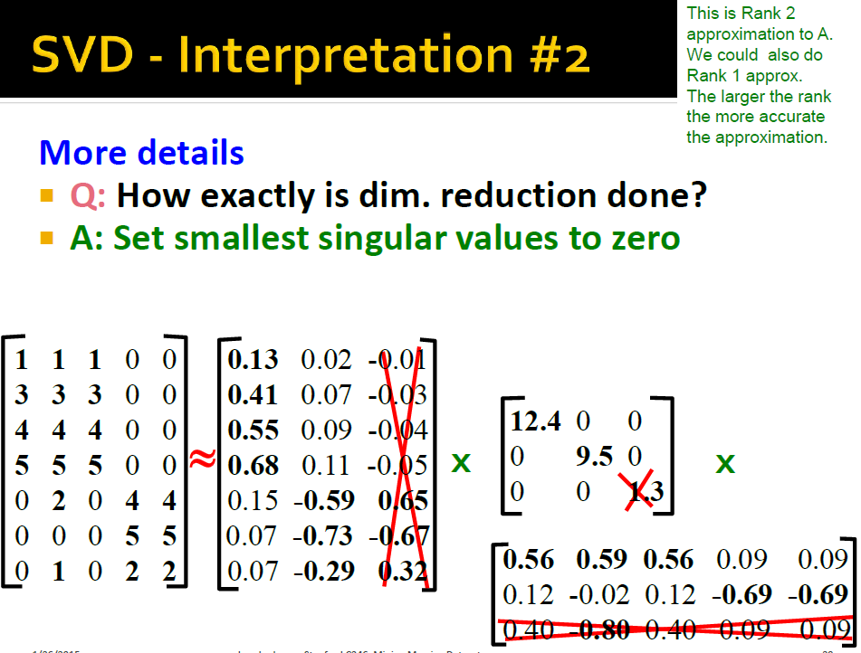

Slide 20
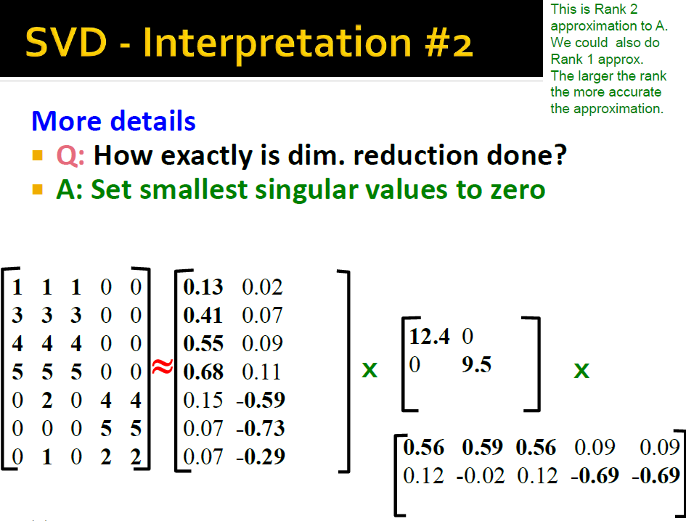

Slide 21
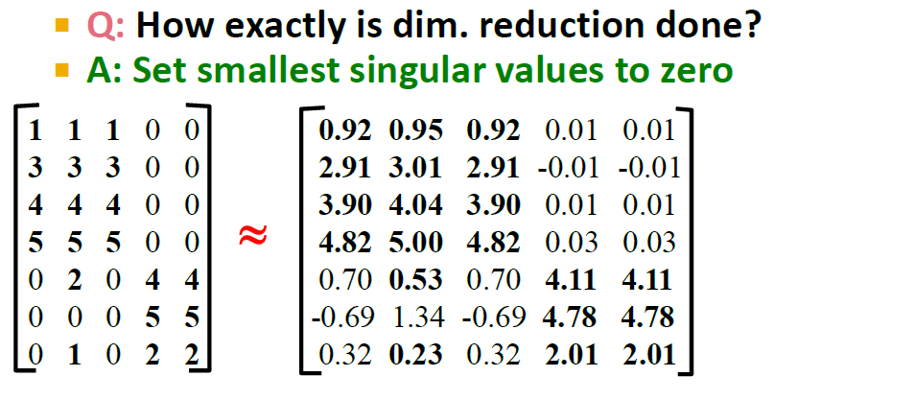
In this simple example, much of the difference is due to rounding error caused by the fact that the decomposition of M was only correct to two significant digits.

Slide 22
How Many Singular Values Should We Retain?
In general, sum of the squares of the retained singular values should be at least 90% of the sum of the squares of all the singular values.
In Example ,the total energy is (12.4)² + (9.5)² + (1.3)² = 245.70, while the retained energy is (12.4)² + (9.5)² = 244.01.
Thus, the retained singular values have over 99% of the energy.
Suppose, second singular value 9.5 is eliminated, then the retained energy would be only (12.4)²/245.70 or about 63%.
Source : http://infolab.stanford.edu/~ullman/mmds/ch11.pdf

